Slide 1
Plausibility Testing Simulations.
Central Queensland | Emerald, Biloela | 15-sep, 15-oct, 15-nov, 15-dec, 15-jan.
Southern Queensland | Dalby, Roma, Goondiwindi | 15-sep, 15-oct, 15-nov, 15-dec, 15-jan.
Northern New South Wales. | Tamworth, Moree, Walgett | 15-oct, 15-nov, 15-dec, 15-jan.
Cultivar | Low Tillering, Medium Tillering, High Tillering.
Density | 4, 6, 8, 12 plants per sq. metre.
Sowing Depth | 30mm.
Row Spacing | 1000mm.
Row Configuration | solid, single skip, double skip.
Years: 1960 - 2016

Slide 2
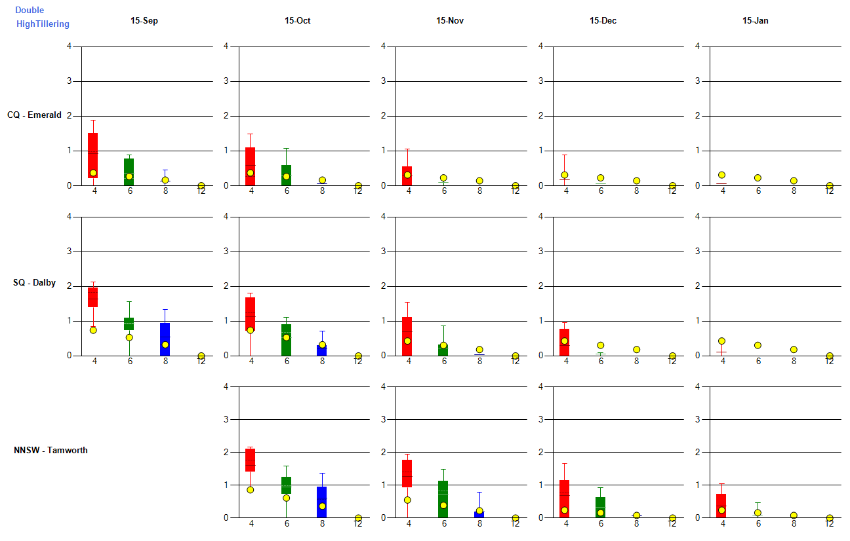
Plausibility Testing Simulations.

Slide 3
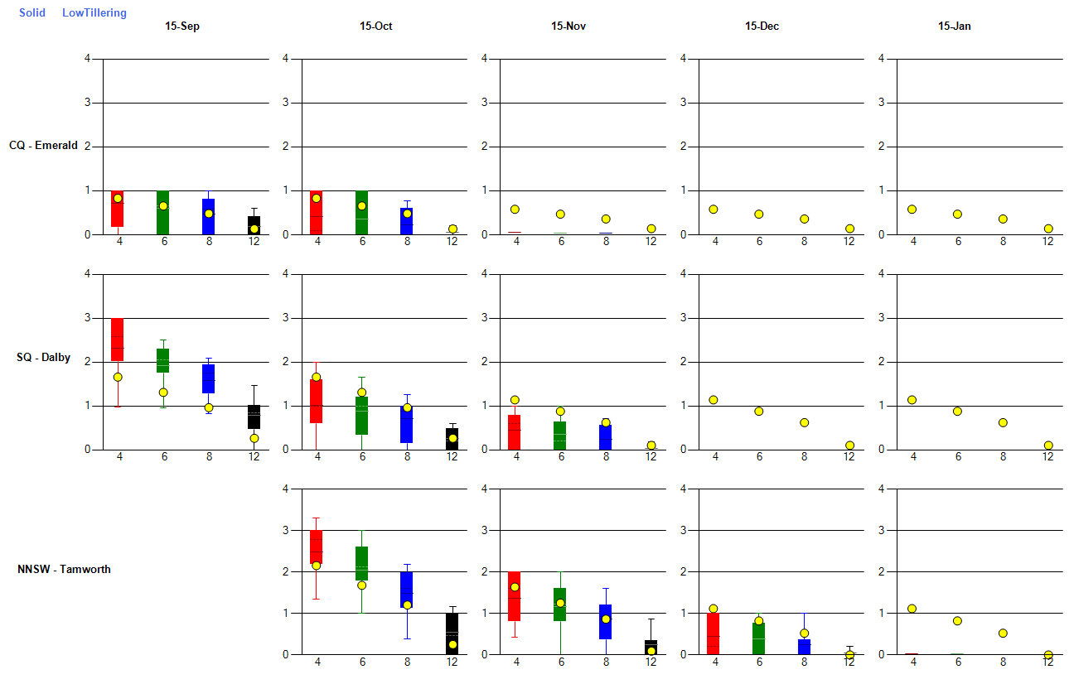
Plausibility Testing Simulations.

